Slide 1
Audience Recognition
Types of Audience

Slide 2
Audience Recognition
Determine whether your audience is:
  High tech
  Low tech
  Lay
  Multiple
  Multicultural Audience
2

Slide 3
High Tech Audience
Work in your field of expertise
Same department or similar capacity in other company
Can be termed as colleagues because they have
  Same educational background
  Same work experience
  Same level of understanding
Writing to high tech audience is easy.
3

Slide 4
Characteristics of High Tech Audience
Are experts in the your field.
High tech jargon, acronyms and abbreviations can be used.
Minimal details about standard procedures or technical theories
Little background information about a project’s history.

Slide 5
Low-Tech Audience
Familiar with your field’s technology but do not know the details.
Include
  Bosses
  Subordinates
  Co-workers in other departments.
  Colleagues in other companies.

Slide 6
Characteristics of Low-tech Audience
Familiar with your field’s technology without knowing details.
Preferable to define jargon, abbreviation and acronyms.
Define technical concepts.
Need for providing background information

Slide 7
Lay Audience
Do not work for the company and have no knowledge about your field of expertise.
Include
  Customers
  Clients
  End users
Writing to lay audience is difficult and demanding.

Slide 8
Characteristics of Lay Audience
Unfamiliar with your field’s technology.
Avoid terms, abbreviations and acronyms (UNO, NUMAL & LUMS) or define them thoroughly.
Avoid high-tech terms or define them thoroughly.
Lay readers need background information.

Slide 9
Multiple Audience
Correspondence is not always sent to just one type of audience.
Challenging to write for multiple audience with different levels of understanding.

Slide 10
Characteristics of Multiple Audience
Provide background data as some of the readers will be unfamiliar with the subject matter. ( Use references )
Define jargon(terms), acronyms and abbreviations. (Within parenthesis)
Use a matter-of-fact business like tone.

Slide 11
Multicultural Audience
Verbal and non-verbal language
Management styles
Decision-making procedures
Sense of time and place
Local values, beliefs and attitudes

Slide 12
Multicultural Audience
Cross cultural communication
Avoid idioms and jargons-
Define acronyms and abbreviations- FYI
Distinguish between nouns & verbs- file, pause code etc.
Cultural biases
Slash marks
Translation-paper size
Numbers and measurements,dates,time

Slide 13
Multicultural Audience
To avoid all these problems use-
Write date completely-January12,2020
Tell what standard measurement/time you will use.
Or use multiple formats-2.30 P.M./14:30
Do not use words like today, tomorrow etc.
Recognise that people have different work schedules globally.

Slide 14
Poor communication
Time to wrap up the deal guys. If we don’t finish the project soon, we’re behind the eight ball. So, here’s what I’m planning for the 0/07/05 12:00 discussion:
Restructured design- rather than build the part at 8x10x2,let’s consider a smaller design.
Shipping method-let’s use a carried/vendor. We’ve not had good luck with Flyrite Overnight. I’m open to your suggestions. Let’s think outside the box and just wing it.
Brainstorm with your men before our teleconference so we can tackle this topic pronto. My boss, the “all and chain", needs our suggestions ASAP, so I need it even sooner. I know you’ll come through with flying colors.

Slide 15
Defining terms for different audience levels

Slide 16
High Tech Audience
  Use jargon, acronym or abbreviation alone
  HTTP
Low Tech Audience
  Use jargon, acronym or abbreviation with parenthetical definition.
  HTTP (Hypertext Transfer Protocol)
Lay Audience
  Use jargon, acronym or abbreviation with extended definition.
  Extended definition = Term + Type + Distinguishing Characteristics.
  HTTP (Hypertext Transfer Protocol) is a computer
  access code providing secure communications on networks.

Slide 17
Biased Language
Issues of Diversity

Slide 18
Issue of Diversity
Your audience will not be composed of people just like you. In contrast, your reader or listener will be more than likely be diverse.
Diversity includes ”gender, race, religion, age, language, family etc.

Slide 19
Multiculturalism
It is also another feature of diversity.
It includes:
  Global Economy
  Different Cultures etc.

Slide 20
Take Care of the Following
Define Acronyms and abbreviations
Avoid jargons and idioms
Distinguish between Nouns and Verbs-paste, code, help, file etc.
Watch for cultural Biases/Expectations-red,black,piggy bank
Avoid humor or puns
Avoid figurative language
Be careful with numbers, measurements, dates, times, facts & figures.
Use of nouns, pronouns and grammar

Slide 21
Avoid Sexist Language
Radium was discovered by a woman, Marie Curie.
Radium was discovered by Marie Curie.
Mrs. Acton, an attractive blonde, is Joe’s assistant.
Mrs. Acton is Joe’s assistant.
The manager is responsible for the productivity of his department.
Management is responsible for departmental productivity.
A good lawyer will make sure that his clients are aware of their rights.
A good lawyer will make sure that clients are aware of their rights.

Slide 22
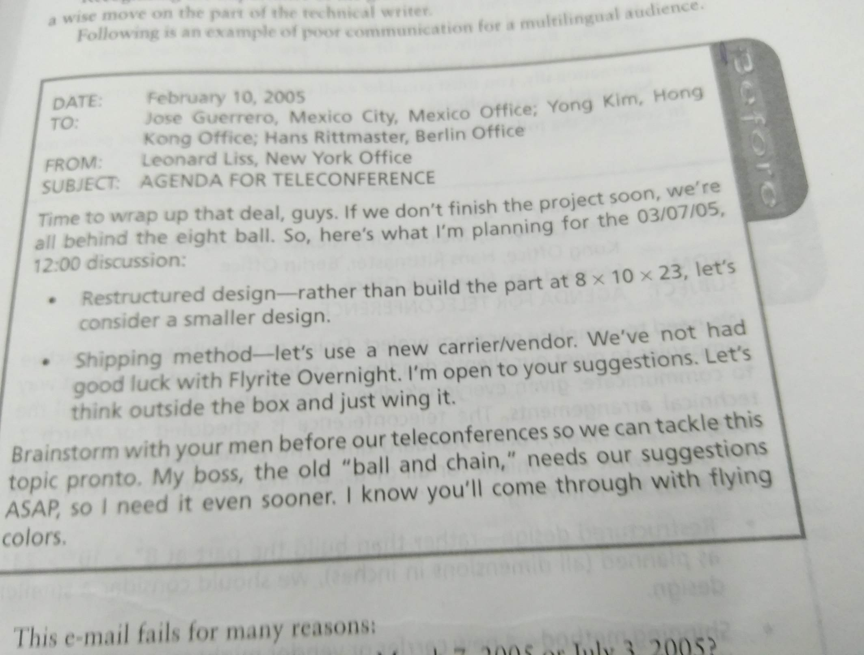

Slide 23
Audience Involvement
Keep your reader interested !!

Slide 24
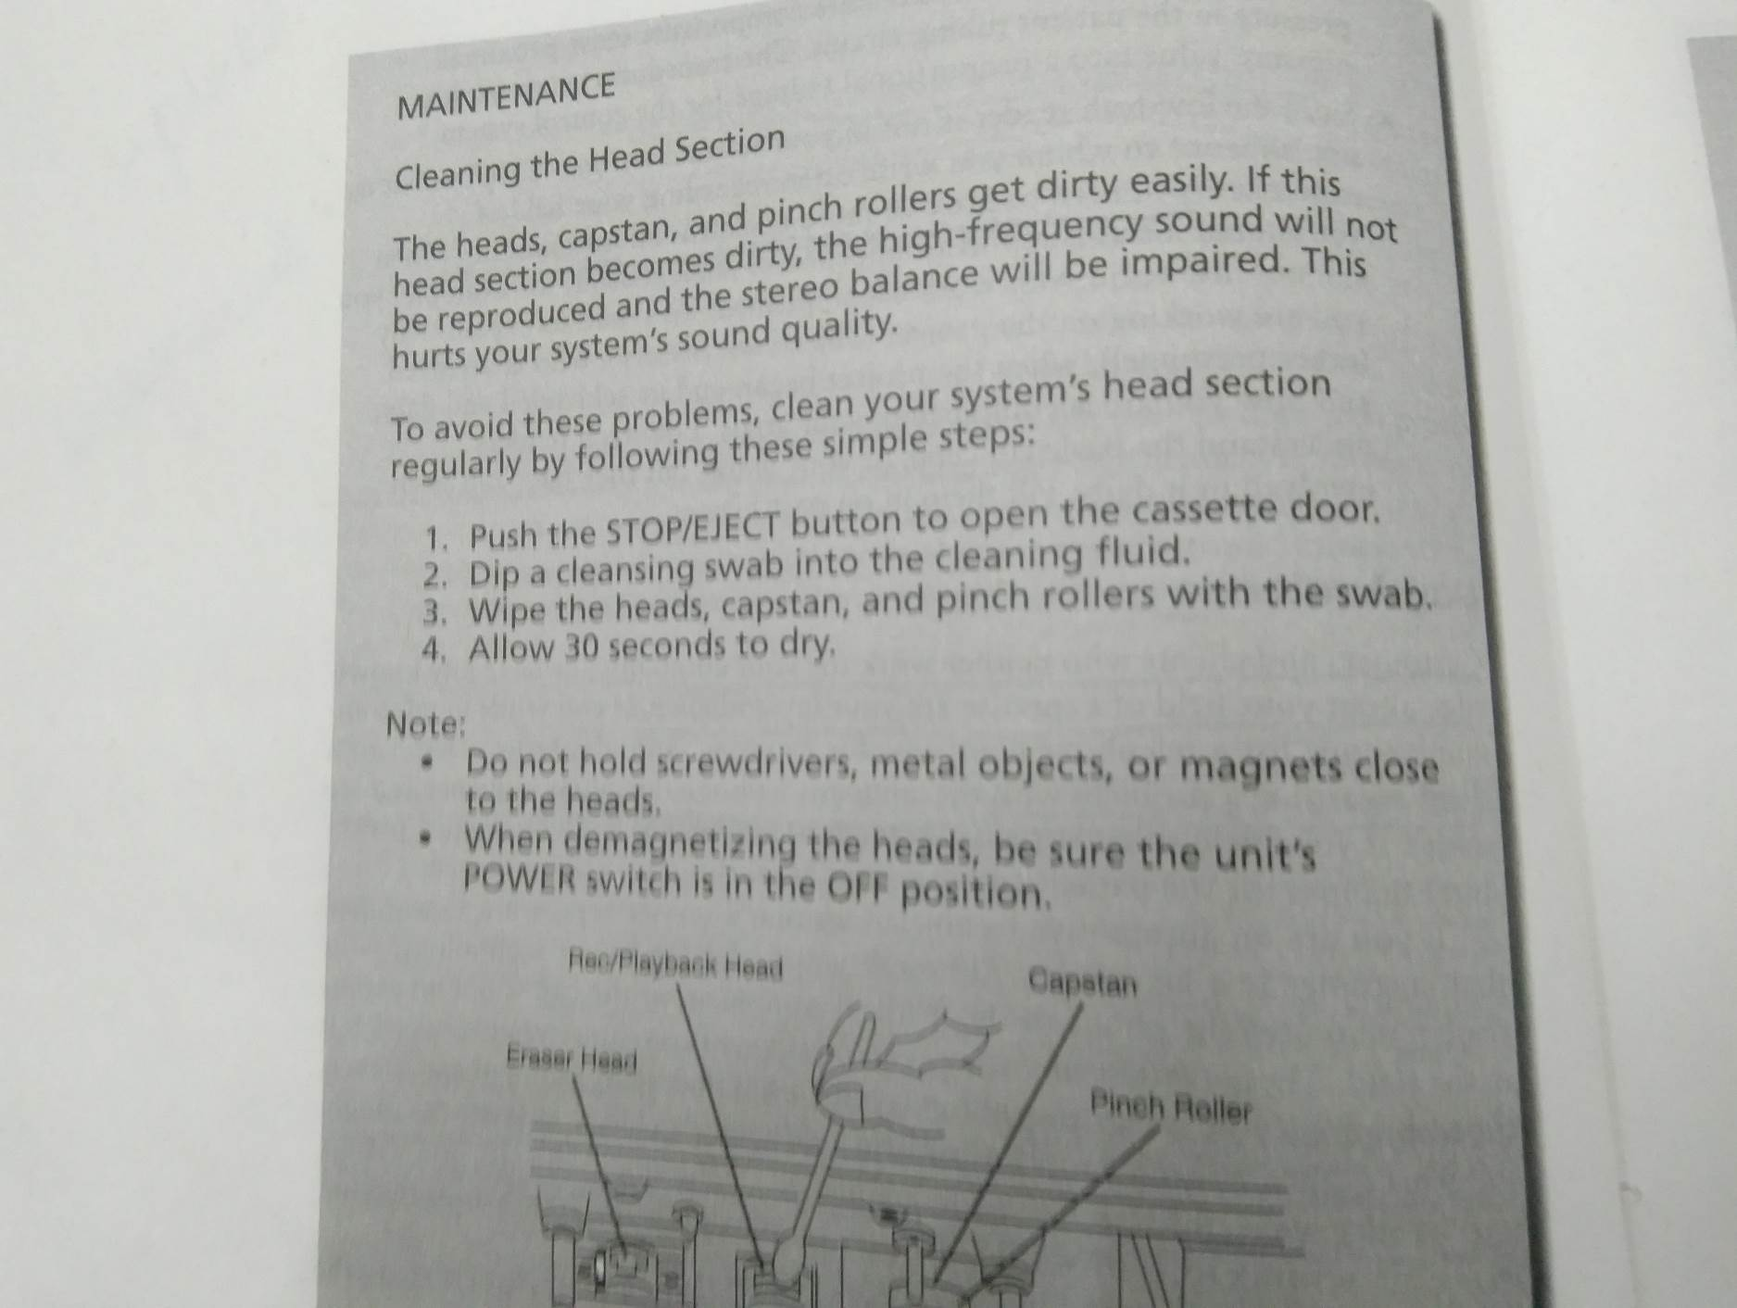
Who is the audience?

Slide 25
Achieve Audience Involvement Through
Personalized Tone
  Modern technical writing is person to person communication.
Reader Benefit
  Motivate your readers by giving them what they want or need.

Slide 26
1. Personalized Tone
Pronoun Usage (You, We, I, etc)
Names (Mr Ali, Mr. Usman, etc)
Contractions (we’re, let’s, can’t, etc)

Slide 27
2. Reader Benefit
Explain the Benefit
  State benefit early or late in the technical document.
Use Positive Verbs and Words
  We’ve received your letter complaining about our services.
  Thank you for writing to us about our services.
  We can not process your request. You failed to follow the printed instructions.
  So that we may process your request rapidly, please fill in line 6 on the printed form.

Slide 28
Defining terms for Different Audience levels
Audience Level | How to Coomunicate | Sample
Hi-Tech | Use jargon, acronyms or abbreviations alone | The waste water is being treated for DBSs
Low -Teach | Use jargon/abbreviation with a parenthesis definition | The wastewater is being treated for DBS(disinfection by products)
Lay audience | Use jargon/abbreviation with a parenthesis definition and a brief definition | The wastewater is being treated for DBS(disinfection by products) such as acid,methane,chlorine,and ammonia.

Slide 29
Guidelines to communicate effectively to a multicultural audience
Define Acronyms and abbreviations
Avoid jargon and idioms
Distinguish between nouns and verbs
Watch for cultural biases/expectations
Be careful when using slashes
Avoid humour/puns
Realize that translation might take more or less space.

Slide 30
Examples
Dear sir
With regard to the lost policy123,enclosed is a lost policy form. Complete this form and return it ASAP, upon receipt, the company will issue a replacement policy.
Dear Mrs Rao
Your lost policy 123 can be replaced easily. I’ve enclosed a form to help us replace it for you. All you need to do is fill it out for us. As soon as we get it, we’ll send you your replacement policy.

Slide 31
Check listDOC_A_Augustosky_ClearWritingChecklist_508.pdf

Slide 32
Change the sentences to positive
We cannot process your request. You failed to follow the printed instruction
The error is your fault. You keep your books incorrectly and cannot complain about our deliveries. If you would corporate with us, we could solve your problem.
We have received your letter complaining about our services.
Your bill is now three weeks overdue. Failure to pay immediately will result in lower credit ratings.
The invoice you sent was useless by the time it arrived. You wanted my time and money.

Slide 33
So that we may process your request rapidly, please fill in line 6 on the printed form.
To ensure prompt deliveries let’s get together to review our book keeping practices. Would next Tuesday be convenient?
Thank you for writing to us about our services.
If you are busy as we are, you’ve probably misplaced our recent bill(mailed three weeks ago).Please send it in soon to maintain high credit ratings.
We’re proud of our ability to maintain schedules. But we need your help. When you return invoices by the fifteenth, we save time and you save your money.

